Slide 1

INTERN LIFE

Slide 2

meme
n. [meem]
An image, video, or piece of text, typically humorous in nature, that is copied and spread rapidly by Internet users, often with slight variations.

Slide 3

Brand awareness
of ExxonMobil

Slide 4
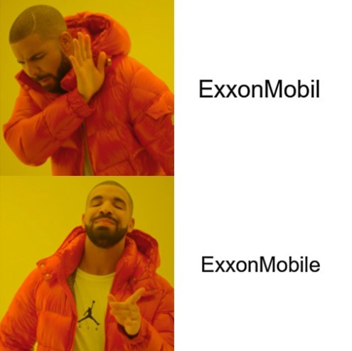
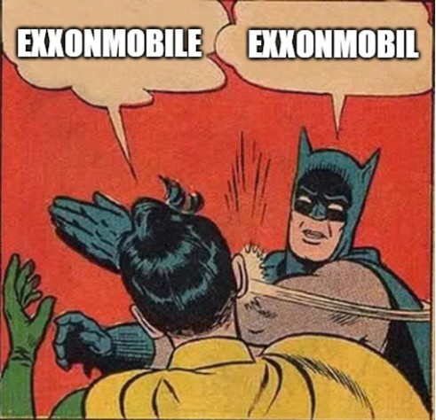

Slide 6

Safety first

Slide 7


Slide 8
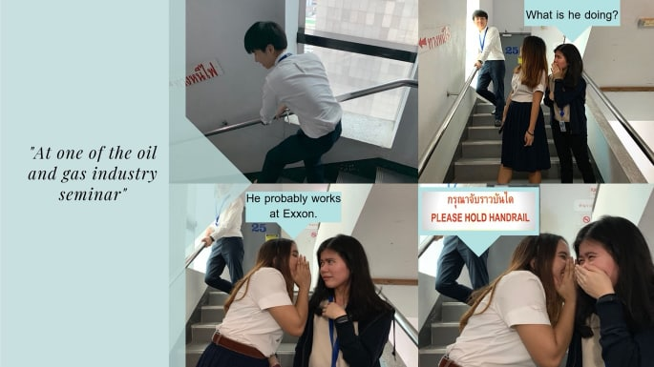

Slide 9


Slide 10
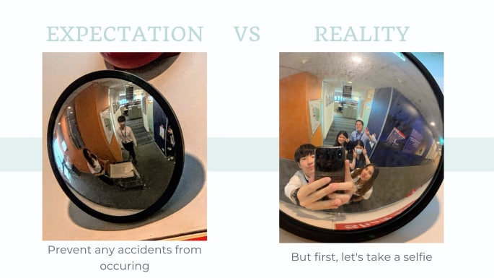

Slide 11

Ergonomic

Slide 12
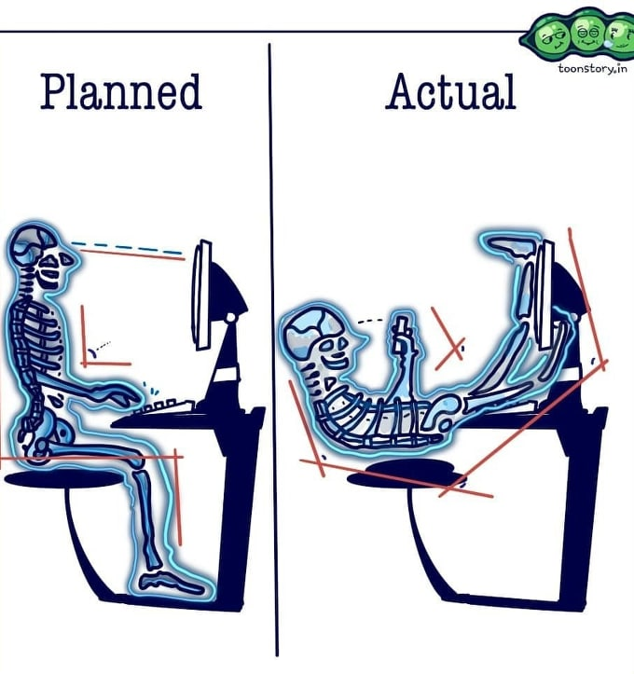


Slide 13

Acronyms

Slide 14
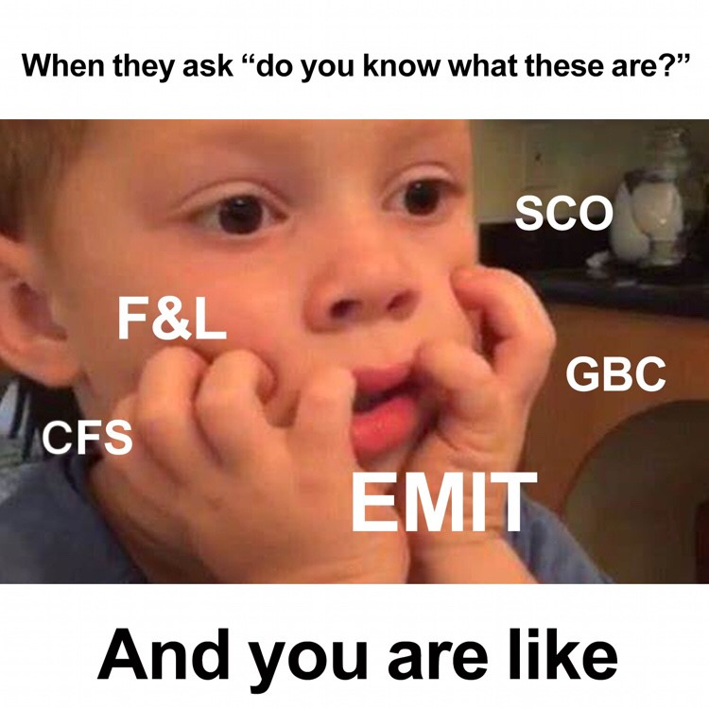
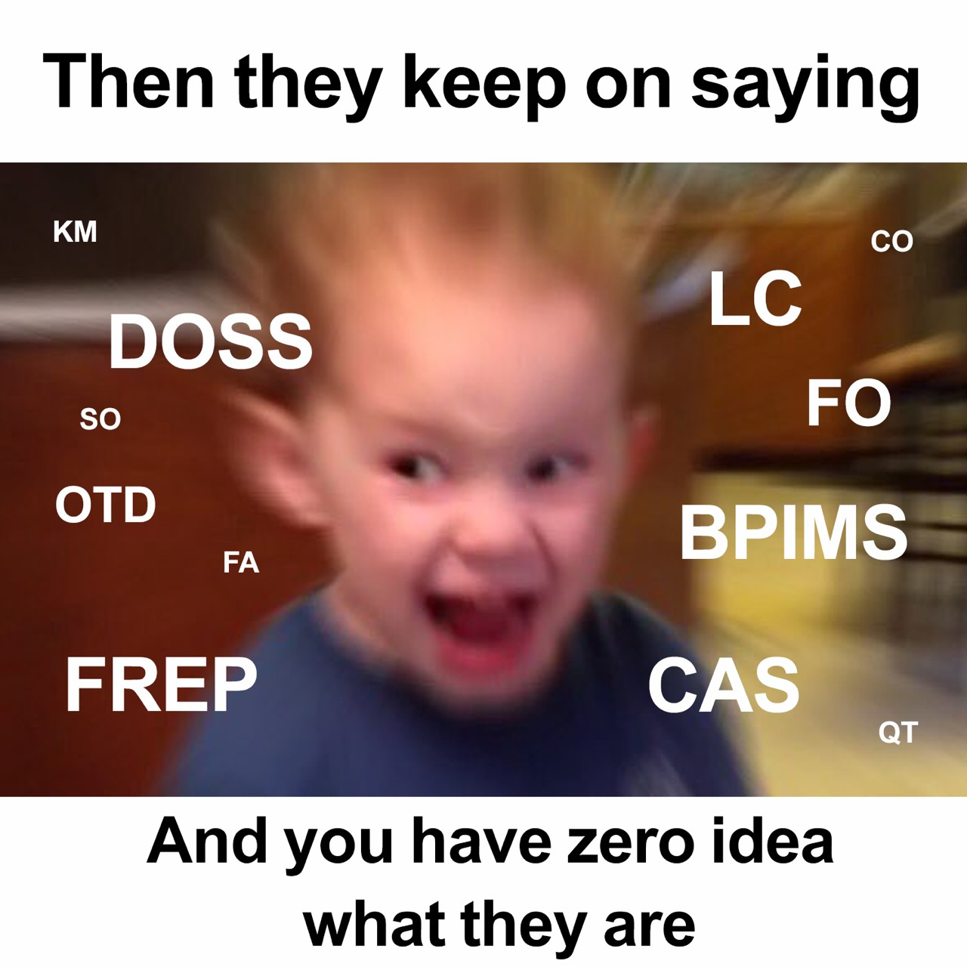

Slide 15


Slide 16


A company that cares

Slide 17


Slide 18


Slide 19




Slide 20


